Slide 1
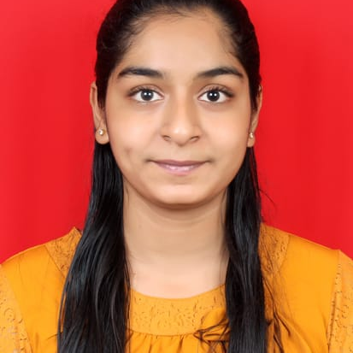



Pranita Jagdale
Analyst/Software Engineer
Bachelor of Engineering
(Information Technology) 2018 - 2022
skills
Mumbai
Java 8 /J2EE | Java Basics, OOPS, Collections, Arrays, Loops, Lambda Expressions
Spring core | Dependency Injection, Autowire
Spring REST | REST controllers, Implementation of GET, POST, PUT & DELETE, Bean Validation & Exception Handling, Controller & Repository layer
Spring Data JPA | Implement DAO layer using spring Data repositories
Spring Boot Microservices | Spring Boot Starters, annotations, Messaging Service using RabbitMq,Swagger API documents
Spring Cloud | Eureka, Spring Cloud API Gateway
Database | MySQL
UI Tech | HTML 5 & CSS 3,JavaScript,Bootstrap,Angular
Tools | Git, Postman, IDE
Add On skills | Time management, Problem-solving skills
pranita-hanumant.jagdale@capgemini.com
+91 8793314981
A4
Full Stack Developer
Hands on experience in creating microservices with Spring Boot, Spring Security, Spring Cloud API Gateway, Eureka server
Proficient in creating Single page Web Application in Angular
Experience in creating documentation with swagger and in unit testing using Junit, Mockito, in messaging service using RabbitMQ, in email service
Flight Booking System
Completed end to end case study of Flight Booking system along with Swagger and payment implementation using Razor Pay, UI with Angular used for user interface.
Hospital Management system
Developed Hospital Management System using Spring Boot, MySQL and testing all api through postman
Check out my work on GitHub & Video profile

